Slide 1
Energy efficient UDN design using reinforcement learning
DGIST
BongSang Kim
JaeHyun Lee
05/July/2019
UGRP Meeting

Slide 2
인턴 기간 동안 한 것
RL 코드- MCTS 알고리즘 사용하기로 결정
Why MCTS? – DQN, MCTS, Actor-Critic….. 이것들 공부하고 이러한 장단점이 있다고 간략히 설명, 그리고 MCTS가 이러이러해서 RL 코드로 쓸 만할것 같다고 판단하였다??
진행상황? 수도코드?
미래계획-재현이가 씀

Slide 3
그동안 한 것
1

Slide 4
Coding
What you have to do until 5.17
Design ultra dense network environment
Determine which reinforcement learning algorithm to use
Do not reinvent the wheel
Google is your another best friend
Github has plenty of good open source materials
The author’s homepage might gives the source code
Run the sample code
0. Understand the code
Run the original code
Makes a pseudo code
Remakes a simplest code based on the original code
Makes “Remark” for better understanding of code
Makes advanced code
Should be done

Slide 5
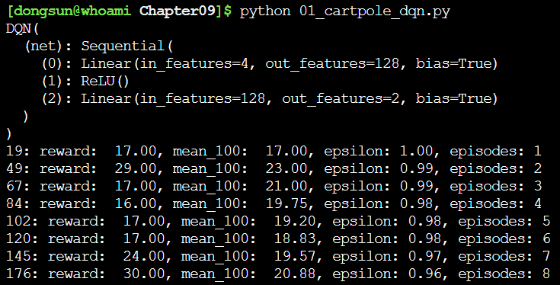
Run the Code
Run the original code
Recommend to use ssh – secure and fast
Download github code
git clone <address>
e.g., git clone https://github.com/PacktPublishing/Deep-Reinforcement-Learning-Hands-On/
Run the code (recommend to use terminal not notebook)

Slide 6
Error – Missed Library
Q.
Makes your own environment (recommend)
https://stackoverflow.com/questions/7465445/how-to-install-python-modules-without-root-access
2. Ask me to add libraries
기왕 할거면 한꺼번에.. 그리고 미리미리

Slide 7
Error – Basic Grammar
Main idea : learn from basic
Version check – ‘pip list | grep <lib>’
Search the tutorial for the version
e.g., Python 3.7.3 tutorial, PyTorch tutorial, Tensorflow tutorial
Github – search the library
Commonly used library
numpy, scipy
matplotlib
gym
Among pytorch, tensorflow, keras, …
ptan
mujoco (unless necessary do not use)
pdb, or ipdb

Slide 8
Error – Unknown
Type error
python, numpy, or pytorch types error
Assignment of different types or shape incur errors
Check error for short code is easy → read carefully
Check error for long code is hard → use python debugger (or c debugger)
ipdb – ipython interface like python debugger
Add following line before the error
‘import ipdb; ipdb.set_trace()’
Set the breakpoint for the code

Slide 9
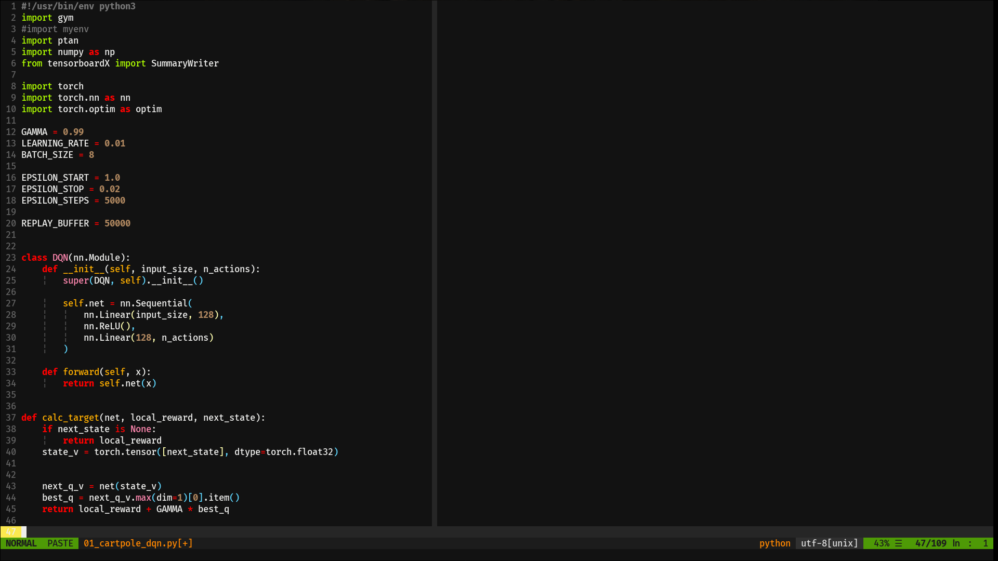
Coding-Example
Chaper09 of Deep~ github code
Import library
Set values for algorithm

Slide 10
Coding-Example
Chaper09 of Deep~ github code
Define Neural Network
Define value iteration

Slide 11
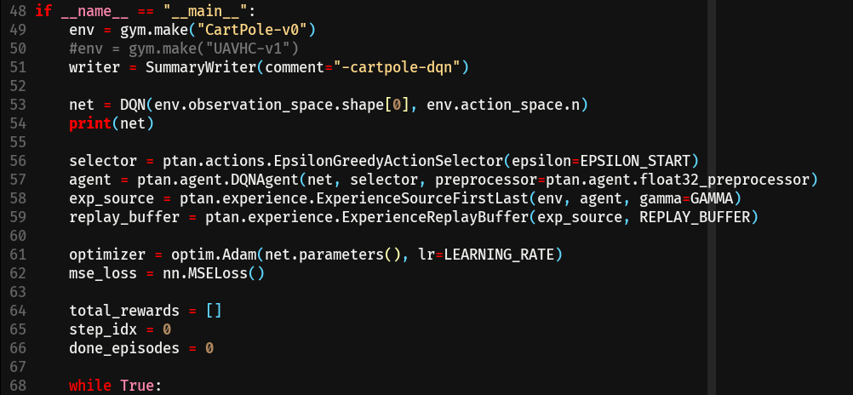
Coding-Example
Chaper09 of Deep~ github code
set gym environment
set neural network
Use ptan wrapper
Set optimizer for training
Initialize training pipeline
Q. What is ptan and how should we deal it?

Slide 12
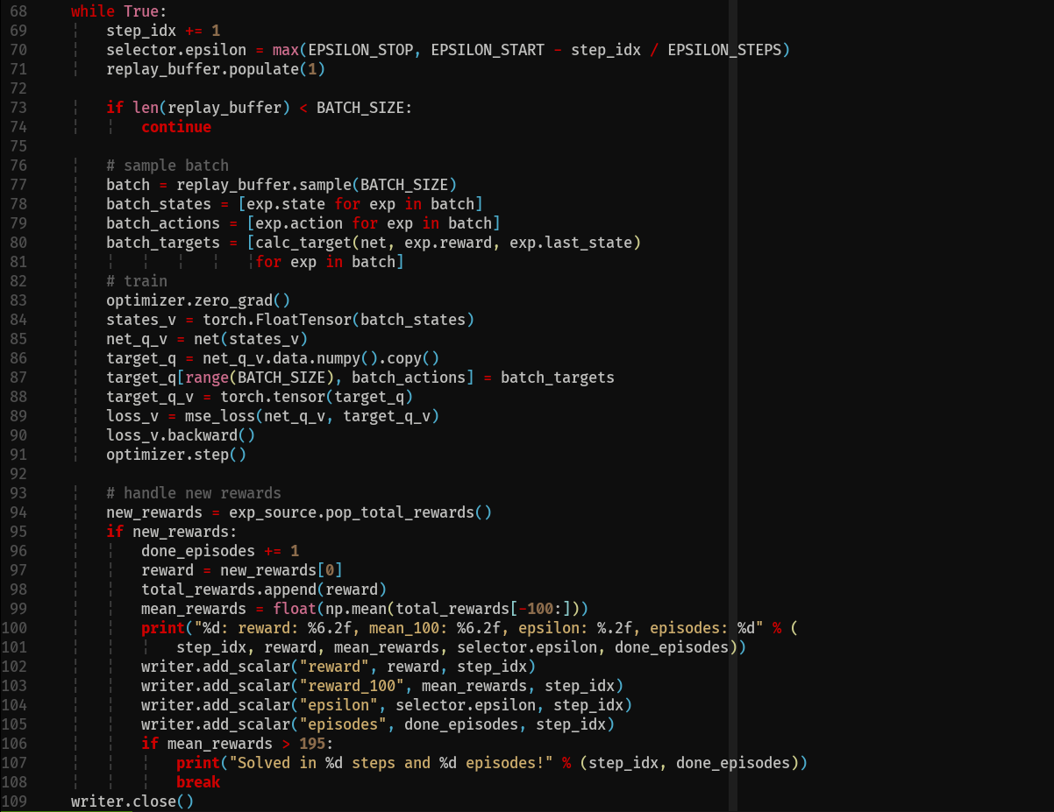
Coding-Example
Epsilon
greedy
Chaper09 of Deep~ github code
Set batch
Initialize optimizing step
Get value from network
Get error in value function
Update network based on loss
Logging
performance

Slide 13
Question
Pseudo code - practice
What is the intention of the code?
Algorithm
Environment
Hyperparameters
Networks
Why they save?

Slide 14
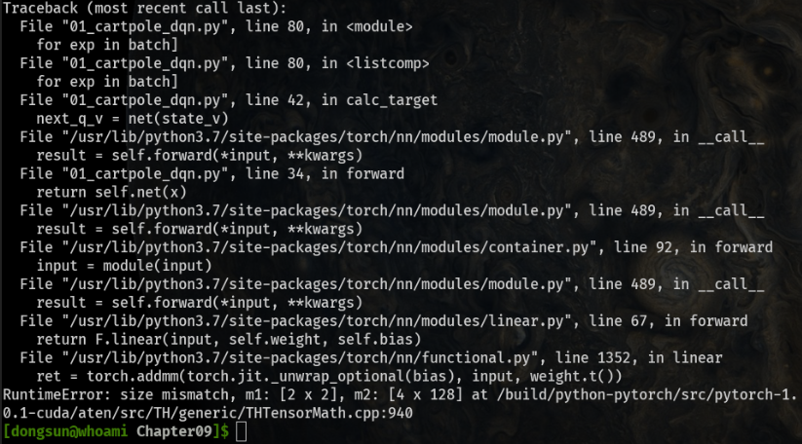
Error – Unknown
ipdb – ipython interface like python debugger

Slide 15
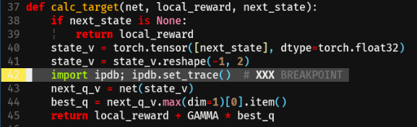
Error – Unknown
ipdb – ipython interface like python debugger
https://pythonadventures.wordpress.com/tag/ipdb/
and more…

Slide 16
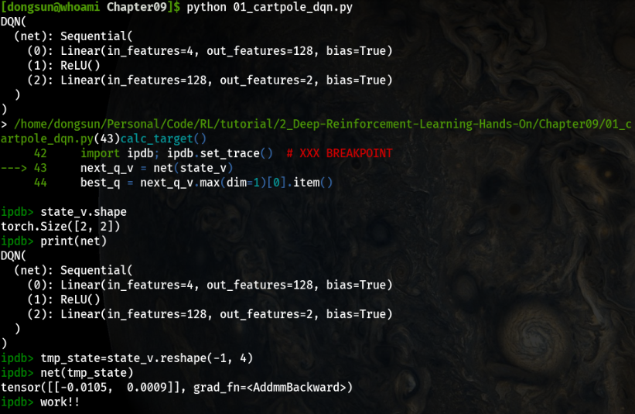
Error – Unknown
ipdb – ipython interface like python debugger

Slide 17
Conclusion
Start point
Google, github, tutorials
Practice makes perfect
Pseudo code
Read the others codes and mimic
Error handling
Most of errors are already experienced and solved by Google
Knowing how to ask is important skill to enhance the code
Python debugger can help unknown error

Slide 18
Thank you
Any Questions?

